Slide 1
Chapter 4
Carbon and the Molecular Diversity of Life

Slide 2
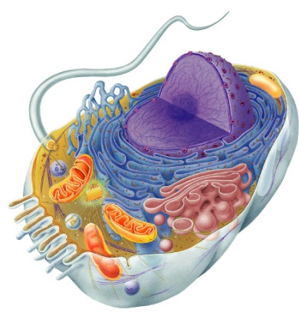
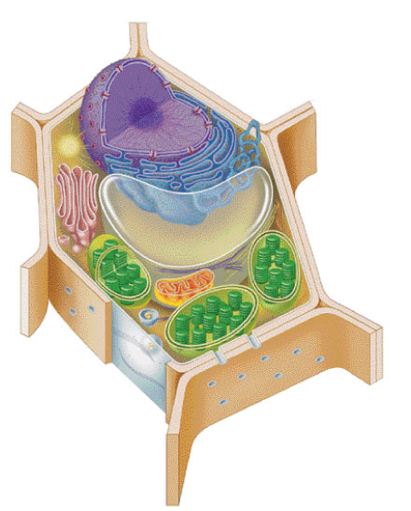

Why study Carbon?
All of life is built on carbon
Cells
  ~72% H₂O
  ~25% carbon compounds
    carbohydrates
    lipids
    proteins
    nucleic acids
  ~3% salts
    Na, Cl, K…
Notes:
Why do we study carbon -- is it the most abundant element in living organisms?
H & O most abundant
C is the next most abundant

Slide 3
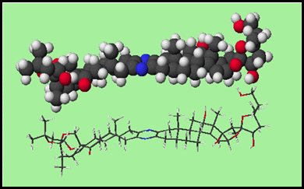
I. Importance of Carbon
Organic chemistry: branch of chemistry that specializes in study of carbon compounds
Organic compounds: contain Carbon (& H)
Major elements of life: CHNOPS
Carbon can form large, complex, and diverse molecules

Slide 4
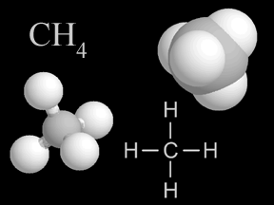
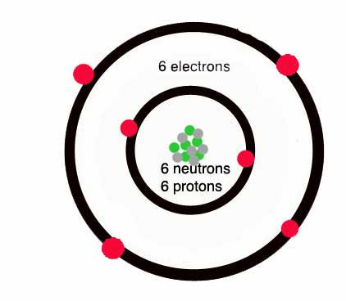
II. Diversity of Carbon
It has 4 valence electrons (tetravalence)
It can form up to 4 covalent bonds
  Most frequent bonding partners: H, O, N

Slide 5
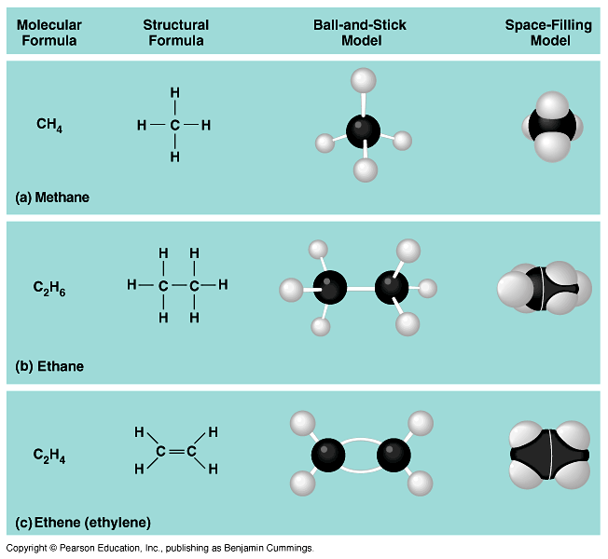
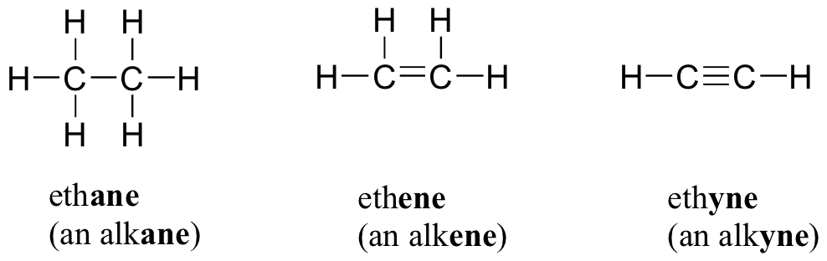
II. Diversity of Carbon
Bonds can be single, double, or triple covalent bonds.

Slide 6
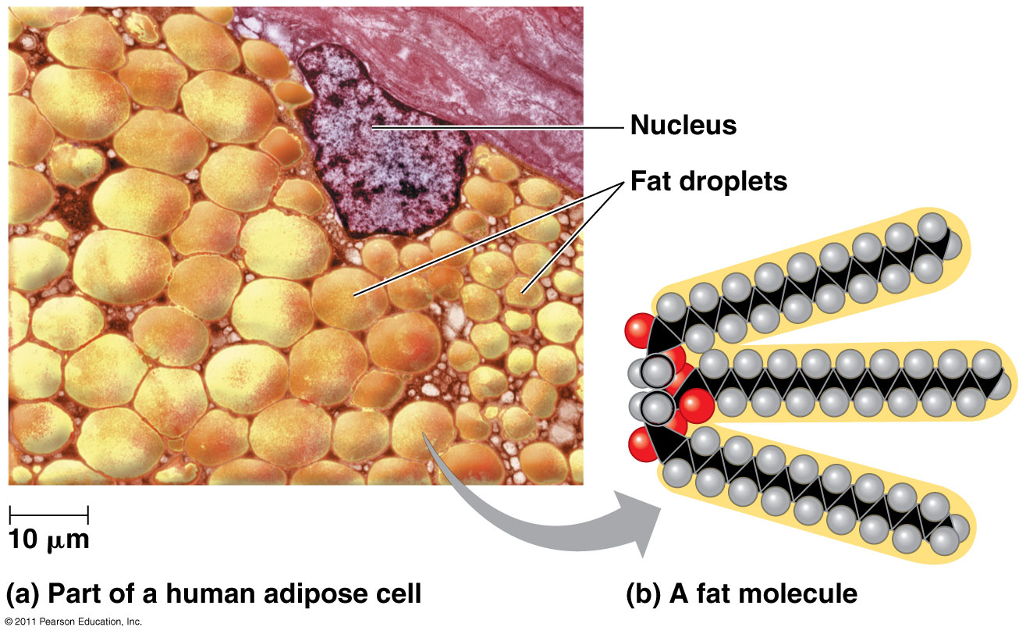
II. Diversity of Carbon
Carbon can form large molecules
  4 classes of macromolecules: carbohydrates, proteins, lipids, nucleic acids

Slide 7
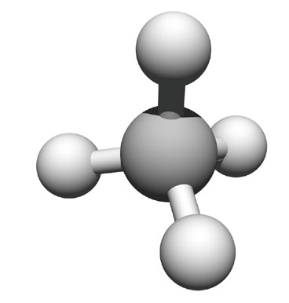
Hydrocarbons
  consist of only carbon and hydrogen
  non-polar
    not soluble in H₂O
    hydrophobic
  stable
  very little attraction
  between molecules
    a gas at room temperature
methane
(simplest HC)

Slide 8
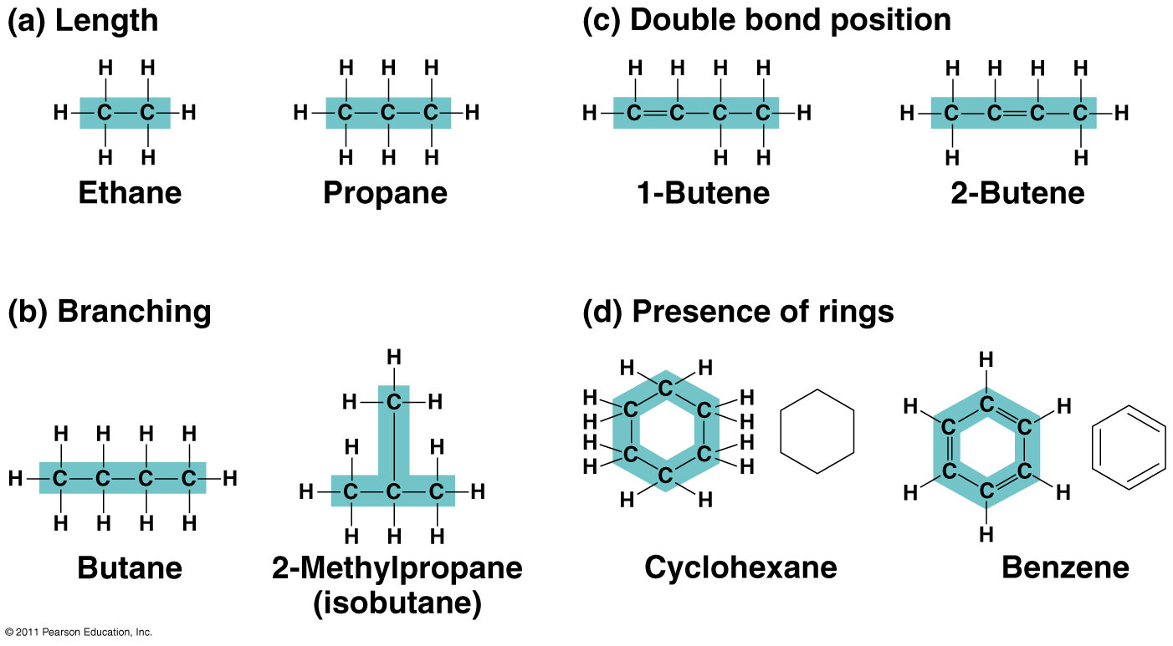
II. Diversity of Carbon
Molecules can be chains, ring-shaped, or branched

Slide 9
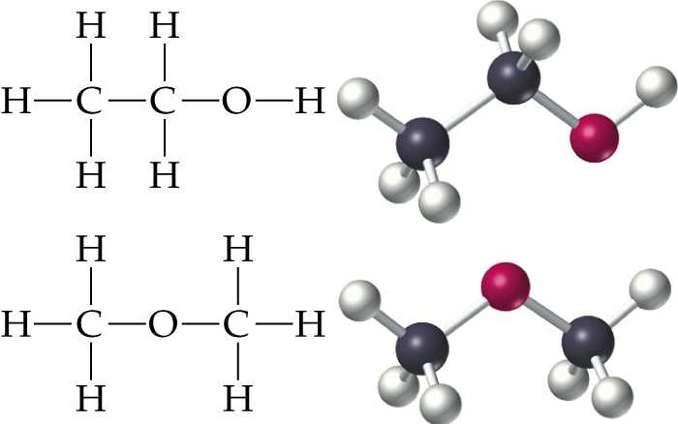
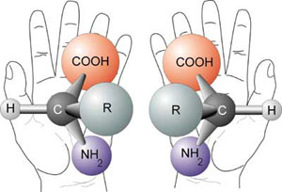

II. Diversity of Carbon
Forms isomers
  Molecules have same molecular formula, but differ in atom arrangement
  different structures → different properties/functions
Three types of isomers are
  Structural
  Geometric/Cis-trans/sterio
  Enantiomers/Chiral
Structural Isomer | Cis-Trans Isomer | Enantiomers
Varies in covalent arrangement | Differ in spatial arrangement | Mirror images of molecules

Slide 10
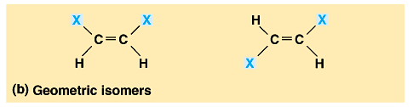
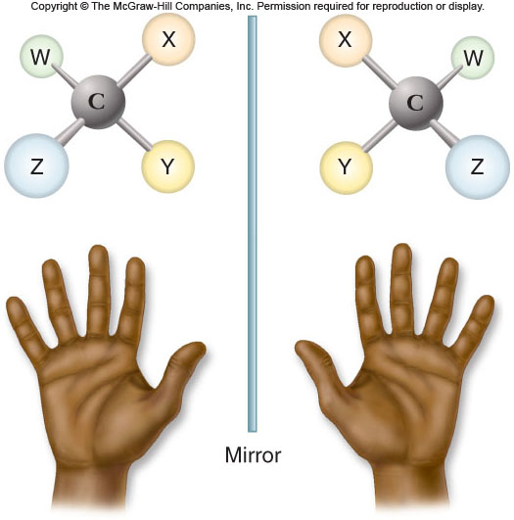
Sterioisomers- differ in arrangement about a double bond
Chiral/Enantiomers- differ in spatial
arrangement around
an asymmetric carbon,
resulting in molecules
that are mirror images,
like left and right
hands.
* Enantiomers CANNOT be
superimposed on each other.
link

Slide 11
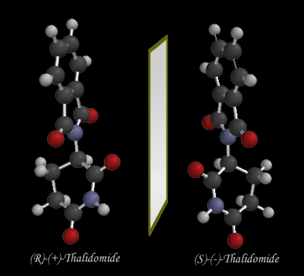
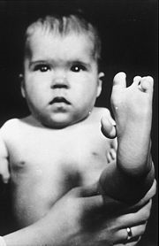
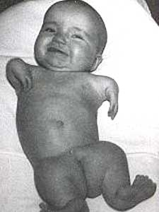
Drug manufacturing:
Thalidomide =
  “good” enantiomer → reduce morning sickness
  “bad” enantiomer → cause birth defects
  “good” converts to “bad” in patient’s body
  Now used to treat cancers, leprosy, HIV

Slide 12
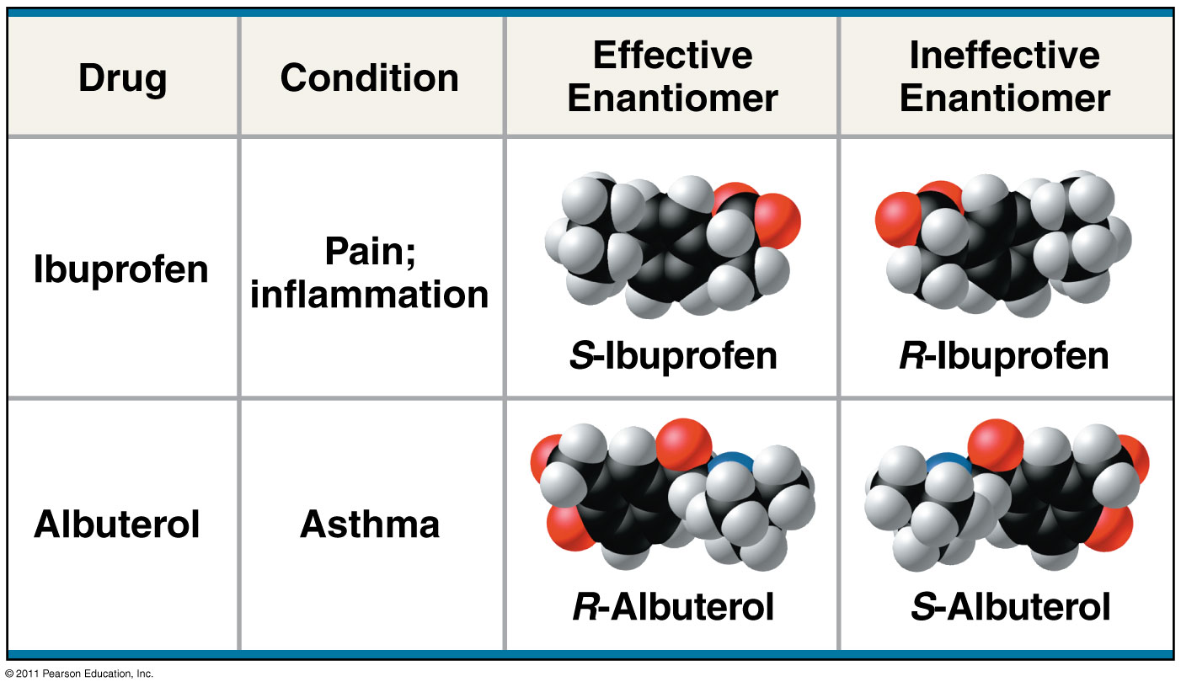
Fig. 4.8 The pharmacological importance of enantiomers

Slide 13
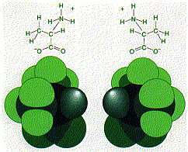
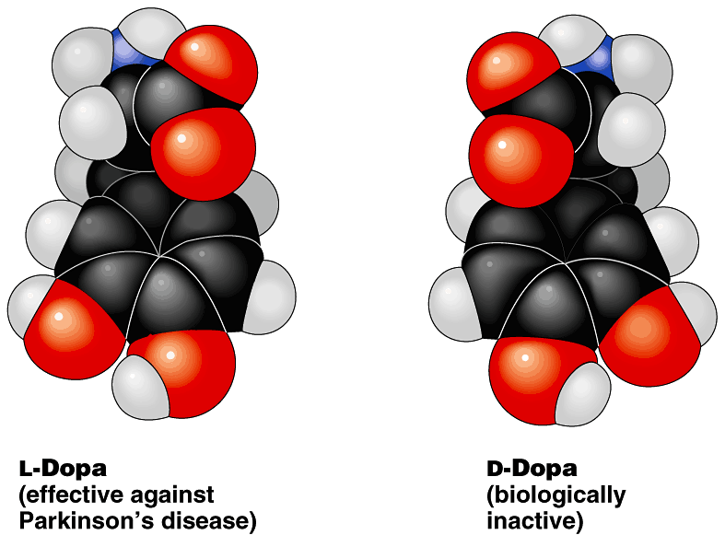
Form affects function
Structural differences create important functional significance
  amino acid alanine
    L-alanine used in proteins
    but not D-alanine
  medicines
    L-version active
    but not D-version
  sometimes with
  tragic results…
stereoisomers

Slide 14
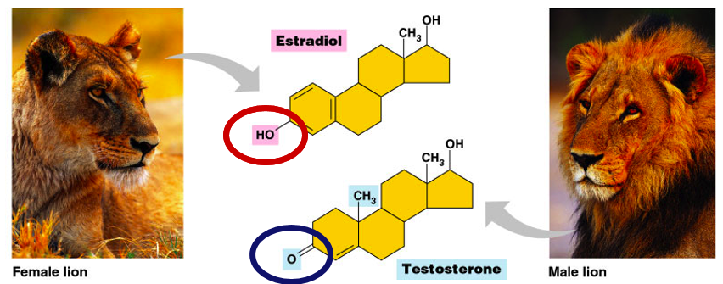
Functional Groups
There are six functional groups that are most important to the chemistry of life: hydroxyl, carboxyl, carbonyl, amino, sulfhydryl, and phosphate groups.
  All are hydrophilic and increase solubility of organic compounds in water.
Basic structure of male & female hormones is identical
  identical carbon skeleton
  attachment of different functional groups
  interact with different targets in the body
    different effects

Slide 15
III. Functional Groups
Behavior of organic molecules depends on functional groups
Most common functional groups:
Hydroxyl
Carbonyl
Carboxyl
Amino
Sulfhydryl
Phosphate
Methyl

Slide 16
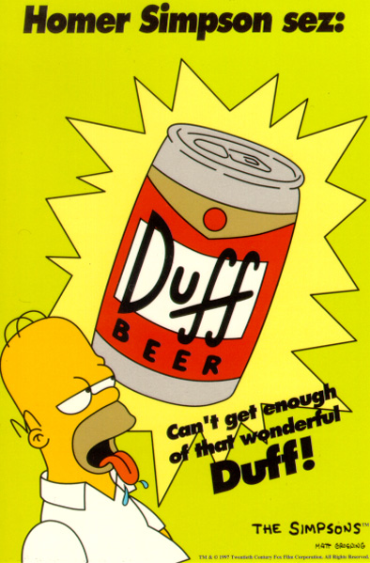
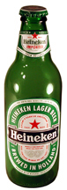
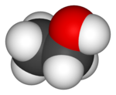


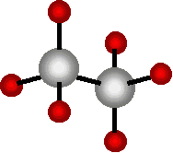

Diversity of molecules
Substitute other atoms or groups around the carbon
  ethane vs. ethanol
    H replaced by an hydroxyl group (–OH)
    nonpolar vs. polar
    gas vs. liquid
    biological effects!
ethane (C₂H₆)
ethanol (C₂H₅OH)

Slide 17
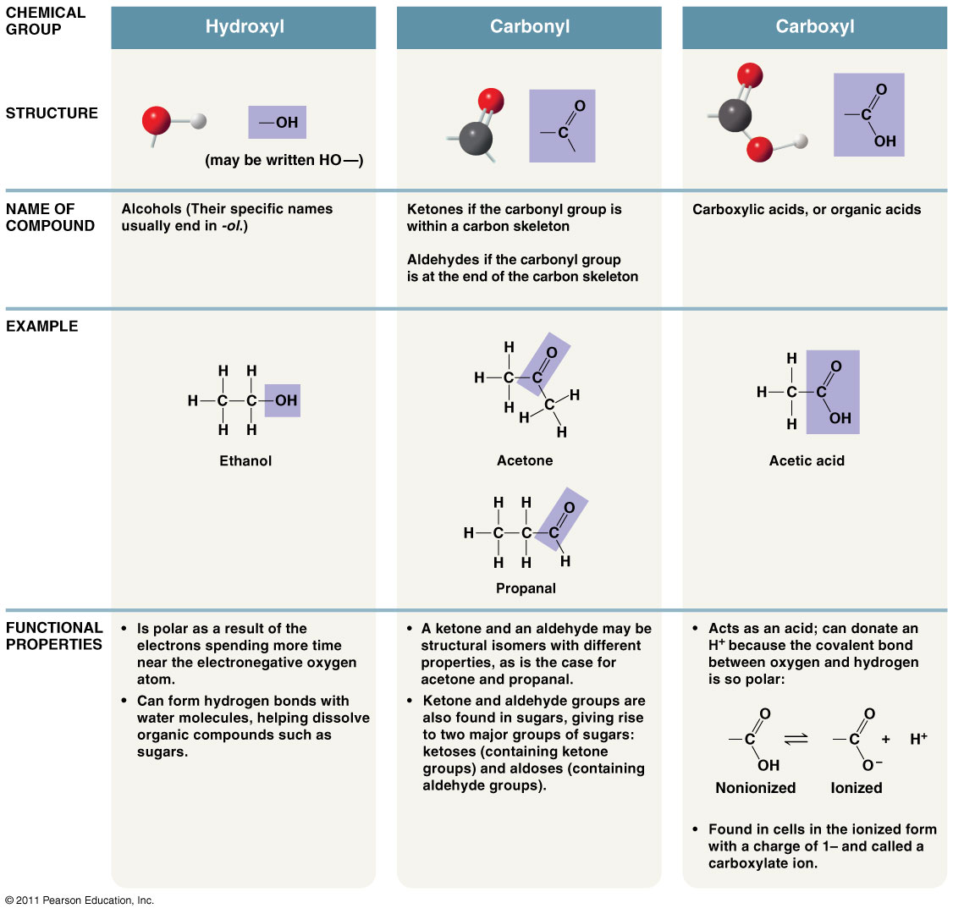

Slide 18
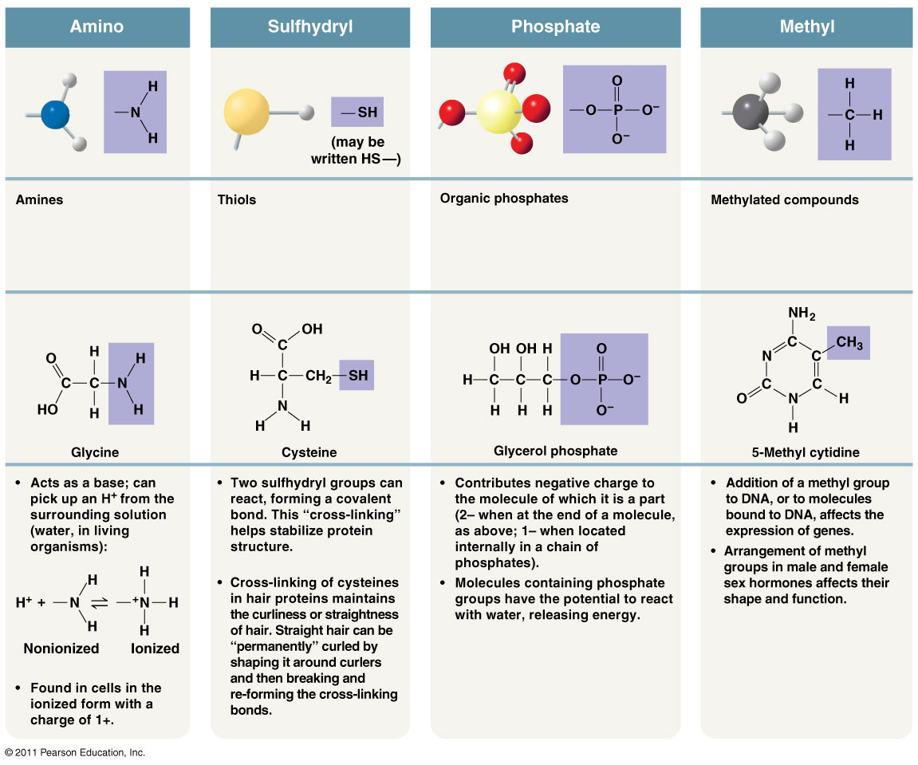

Slide 19
Functional Groups
Functional Group | Molecular Formula | Names & Characteristics | Draw an Example
Hydroxyl | -OH | Alcohols | Ethanol
Carbonyl | >CO | Ketones (inside skeleton) Aldehydes (at end) | Acetone Propanol
Carboxyl | -COOH | Carboxylic acids (organic acids) | Acetic acid
Amino | -NH₂ | Amines | Glycine
Sulfhydryl | -SH | Thiols | Ethanethiol
Phosphate | -OPO₃²⁻ / -OPO₃H₂ | Organic phosphates | Glycerol phosphate
Methyl | -CH₃ | Methylated compounds | 5-methyl cytidine

Slide 20
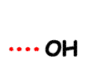

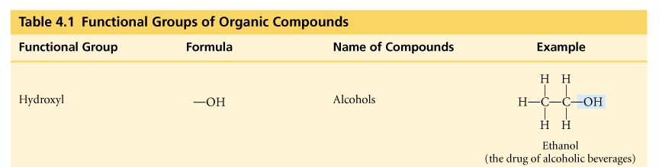
Hydroxyl
–OH
  organic compounds with OH = alcohols
  names typically end in -ol
    ethanol

Slide 21
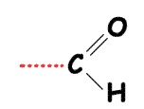
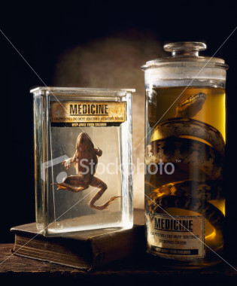
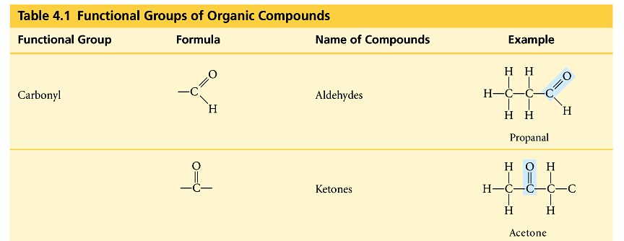
Carbonyl
C=O
  O double bonded to C
    if C=O at end molecule = aldehyde
    if C=O in middle of molecule = ketone

Slide 22
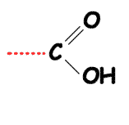

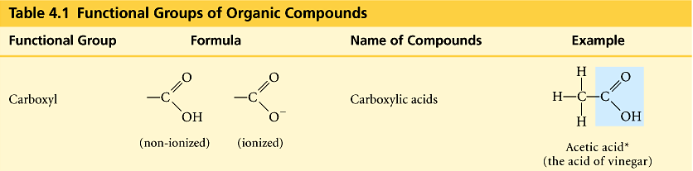
Carboxyl
–COOH
  C double bonded to O & single bonded to OH group
    compounds with COOH = acids
      fatty acids
      amino acids

Slide 23
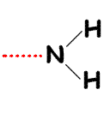
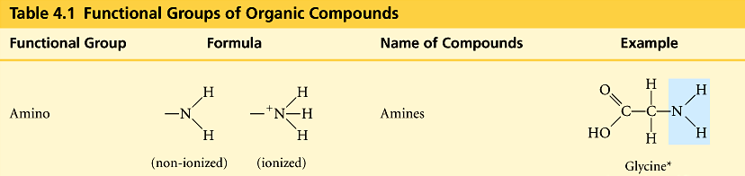
Amino
-NH₂
  N attached to 2 H
    compounds with NH₂ = amines
      amino acids
    NH₂ acts as base
      ammonia picks up H⁺ from solution

Slide 24
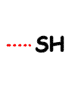
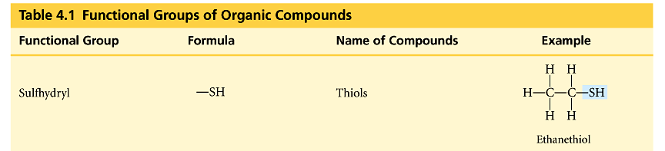
Sulfhydryl
–SH
  S bonded to H
    compounds with SH = thiols
    SH groups stabilize the structure of proteins

Slide 25
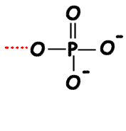
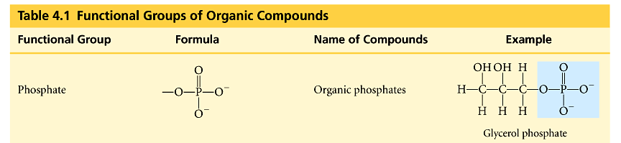
Phosphate
–PO₄
  P bound to 4 O
    connects to C through an O
    lots of O = lots of negative charge
      highly reactive
    transfers energy between organic molecules
      ATP, GTP, etc.

Slide 26
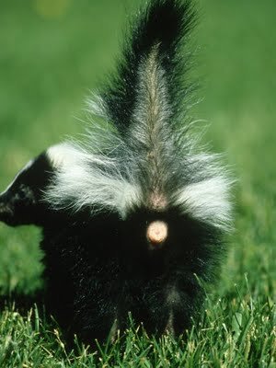
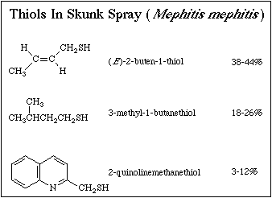
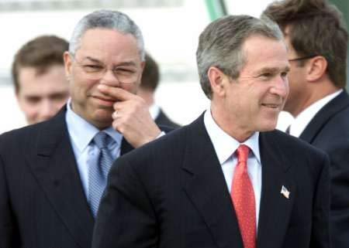
Which functional group is responsible for this unfortunate event?
Phew! “W”! Close skunk encounter?

